Slide 1
SharePoint Online Configuration with PowerShell – Advanced Scenarios

Slide 3














Thank you TO Our Sponsors

Slide 4
Agenda
Introduction
Previous talks
What we’re concentrating on
Keeping up-to-date
Making a connection
Group-less Team Sites
Content types, templates, libraries, views
Deleting all list items
Featured links on the SharePoint home page
Navigation
Property bag configuration

Slide 5
Introduction
What are we trying to achieve?
Why?

Slide 6
An Aside…
Talk to your users and find out what they want
This includes both end users and management
Plan
Prototype
Test
Implement
Don’t try to do everything in one go!
A phased implementation generally works better

Slide 7
Previous Talks…

Slide 8
PowerShell Options
SharePoint Online Management Shell
Basic, tenant level admin
SharePoint PnP PowerShell
Far more fully featured
Maturing rapidly
CSOM PowerShell
Roll-your-own
More complex
The only option for items not covered by the above frameworks
Also Office 365 PowerShell for user and license administration

Slide 9
Obtaining and Installing
SharePoint PnP PowerShell
https://github.com/SharePoint/PnP-PowerShell
Install-Module SharePointPnPPowerShellOnline
Ends up in C:\Program Files\WindowsPowerShell\Modules\SharePointPnPPowerShellOnline\<version>
Or download the setup files and install the cmdlets manually
Updated monthly.
You can work with a specific version if required, but recommended to keep up-to-date
Older versions may have incompatibilities with later versions of SharePoint Online

Slide 10
Obtaining and Installing
CSOM PowerShell
grab nuget.exe from https://www.nuget.org/downloads
nuget.exe install Microsoft.SharePointOnline.CSOM
This will install to a set of sub-folders in the current directory
Or, can be installed globally (within the C:\Program Files\PackageManagement\NuGet\Packages\Microsoft.SharePointOnline. CSOM.<version>\lib folder) by using install-package microsoft.sharepointonline.csom -Source nuget.org
New version released monthly with new functionality. See https://dev.office.com blog or https://techcommunity.microsoft.com for announcements (although these tend to be hard to find).

Slide 11
Getting Connected
SharePoint PnP PowerShell
Connect-PnPOnline –Url https://mydomain.sharepoint.com
Use Disconnect-PnPOnline at the end of your session
Has some funky options, including
-CurrentCredentials
-SPOManagementShell
-AppId <String>-AppSecret <String>
-Credentials <String> - will look up cred set in the Windows Credentials Manager
-UseWebLogin for those who have MFA enabled

Slide 12
Getting Connected
CSOM PowerShell
Add-Type -Path "<pathtoCSOMmodule>\Microsoft.SharePoint.Client.dll"
Add-Type -Path "<pathtoCSOMmodule>\Microsoft.SharePoint.Client.Runtime.dll"
$siteUrl = “https://mydomain.sharepoint.com/”
$username = "Andy@mydomain.onmicrosoft.com"
$password = Read-Host -Prompt "Enter password" -AsSecureString
$ctx = New-Object Microsoft.SharePoint.Client.ClientContext($siteUrl)
$credentials = New-Object Microsoft.SharePoint.Client.SharePointOnlineCredentials($username, $password)
$ctx.Credentials = $credentials
Notes:
See, I told you that you have to do everything yourself!

Slide 13
What We’re Concentrating On
SharePoint PnP PowerShell
CSOM/other where required
SharePoint Online Management Shell will NOT be covered

Slide 14
Keeping Up-To-Date

Slide 15
Keeping Up-To-Date
Keeping modules up-to-date is important.
If you don’t, you’ll start seeing odd errors when running scripts as you end up with a larger and larger mismatch between your module version(s) and what SharePoint Online is running.
Use Update-Module to keep the PnP PowerShell and CSOM modules up-to-date.
Note: If installed centrally, you’ll need admin credentials to update.

Slide 16
Update-Module
Update-Module -Name SharePointPnPPowerShellOnline
However, this leaves old versions of the module still installed.
Get-InstalledModule -Name SharePointPnPPowerShellOnline –AllVersions
Get-InstalledModule -Name SharePointPnPPowerShellOnline -RequiredVersion 3.6.1902.2 | Uninstall-Module

Slide 17
Automation of the Process
$LatestModule = Get-InstalledModule -Name SharePointPnPPowerShellOnline
$AllModules = Get-InstalledModule -Name SharePointPnPPowerShellOnline -AllVersions
foreach ($m in $AllModules)
{
if ($m.version -ne $LatestModule.version)
{
Write-Host "Uninstalling $($m.name) - $($m.version) [latest is $($LatestModule.version)]"
$m | uninstall-module -force
}
}

Slide 18
Making a Connection

Slide 19
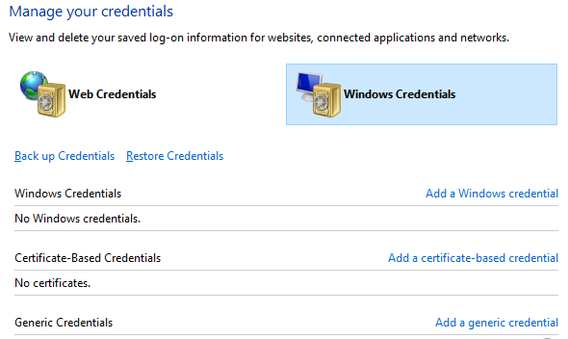
Making a Connection
The Windows Credential Manager can be used to store authentication credentials for Office 365
Create a ‘generic credential’
As long as the URL specified in the stored credential matches the web application URL, those credentials will be used. Note that you can be more specific with the URL used, or create a label instead (and then specify that with Connect-PnPOnline
Very useful for Support personnel

Slide 20
Of Course…
Set the stored credentials using PowerShell
# Install the CredentialManager module from the PowerShell Gallery
Install-Module CredentialManager
# Show the available commands
Get-Command -Module CredentialManager
# Create a new stored credential
$Target = "https://mydomain.sharepoint.com"
$UserName = "AdminUser@domain.onmicrosoft.com"
$Secure = Read-host -AsSecureString
New-StoredCredential -Target $Target -UserName $UserName -SecurePassword $Secure -Persist LocalMachine -Type Generic

Slide 21
Be Aware…
If using this method…
And you leave the module on the machine…
And the machine user has access to it…
And the user works out how to use it…
They can retrieve the password for the account

Slide 22
Group-less Team Sites

Slide 23
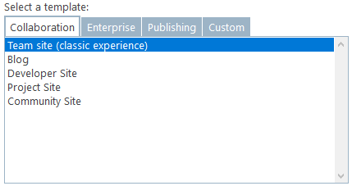
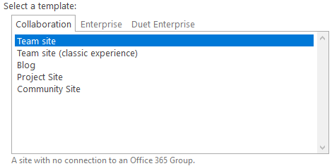
Group-less Team Site
Modern Team Site – just not connected to an Office 365 Group – permissions done the classic way
Not available on the classic site collection creation menu
Available on the sub-site creation menu on classic site
What happens if we want a site collection created like this?
?

Slide 24
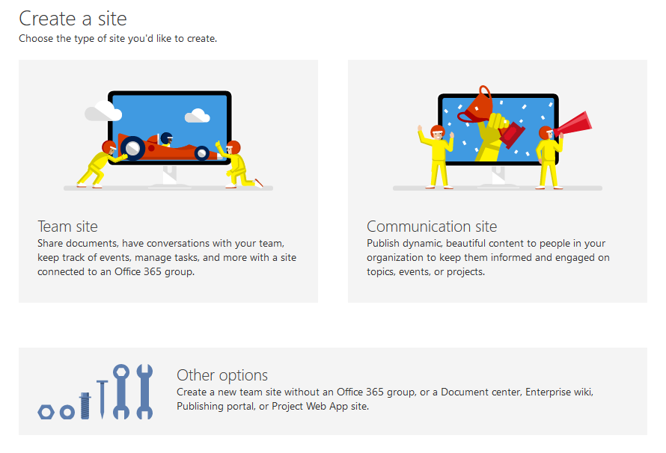
Group-less Team Site
The option IS available when creating from the Modern Admin Center
Not available when using the ‘Create site’ link from e.g. the SharePoint page

Slide 25
PowerShell to the Rescue!
We can create a group-less Team site using PowerShell:
New-PnPTenantSite -Title "Group-less Team Site" -Url https://mydomain.sharepoint.com/sites/Team -Description "Group-less Team Site" -Owner Andy@mydomain.onmicrosoft.com -Template STS#3 -TimeZone 2
Use Get-PnPTimeZoneId to retrieve a list of time zones for use

Slide 26
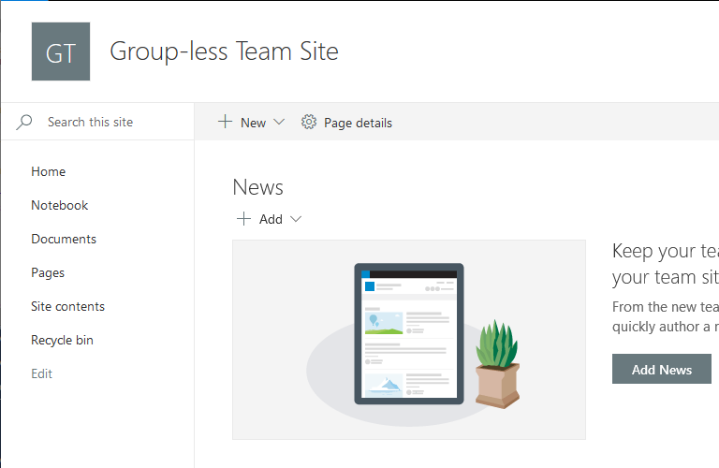
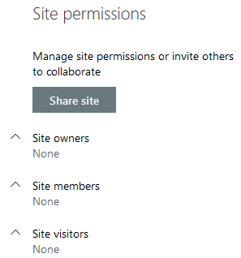
Results

Slide 27
Modern Sub-Sites
You can use PowerShell to create Modern sub-sites even when not supported (e.g. Communication site collection sub-site).
This should NOT be used in production until Microsoft support this scenario.
Modern Team sub-sites can be created, check the GUI to see where this is supported.

Slide 28
Content Types, Templates, Libraries, Views

Slide 29
Content Types
Can be centrally managed in the Content Type Hub
https://mydomain.sharepoint.com/sites/contenttypehub
Must be published to be come available in other site collections; this can be a limiting factor as we have to wait for the publishing timer jobs
Can be created in each site collection required
If you want the same content type in each site collection, ensure you specify the ID
Failing to specify the ID (or using the CUI to create content types in multiple site collections results in content type =/= content type

Slide 30
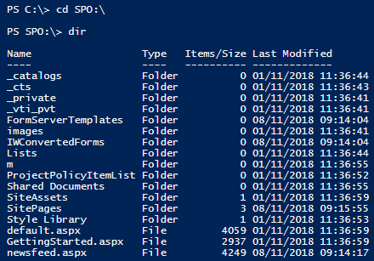
CreateDrive Option
Connect-PnPOnline -Url https://mydomain.sharepoint.com -CreateDrive
Creates an SPO:\ drive
Very useful for exploring
Notes:
I’ve seen weirdness around access to the _cts folder particularly. Needing to change to /sites/CS/_cts

Slide 31
Create Columns
We can use PnP PowerShell to quickly and easily create columns, for example:
Add-PnPField -DisplayName "Policy Owner" -InternalName "PolicyOnwer" -Type User -Group “MyDomain Columns“
Add-PnPField -DisplayName "Policy Review Date" -InternalName "PolicyReviewDate" -Type DateTime -Group “MyDomain Columns"

Slide 32
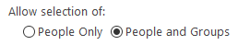
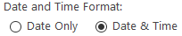
However…
Columns created this way conform to the defaults for columns created via the GUI. Examples:
User column:
DateTime column:

Slide 33
Create with Greater Control
Specific column configuration is stored in ‘SchemaXml’:
We can use the ‘Add-PnPFieldFromXml’ command to have more control over the creation process.
Create a column via the GUI and examine its SchemaXml field to determine the options you require.
Don’t need to include all options and specifically not SourceID

Slide 34
Add-PnPFieldFromXml
Add-PnPFieldFromXml '<Field Type="DateTime" DisplayName="Policy Review Date 2" Required="FALSE" EnforceUniqueValues="FALSE" Indexed="FALSE" Format="DateOnly" Group="W4052 Columns" FriendlyDisplayFormat="Disabled" ID="{7831d5d2-6a2e-462a-96fb-976f61df1df7}" StaticName="PolicyReviewDate2" Name="PolicyReviewDate2"></Field>'

Slide 35
Before We Create A Content Type…
Content Type Templates
These are stored in a hidden list in the site collection
_cts
Files are stored in folders within the hidden list. The folder name is the same as the content type name
Once uploaded the URL for the template can be built and applied to the content type

Slide 36
Uploading and Assigning a Template
Create the appropriate folder
Upload the template
Assign it to the content type

Slide 37
Uploading and Assigning a Template
Create the appropriate folder – PnP PowerShell does this
Upload the template
Assign it to the content type

Slide 38
Create the Content Type
# Setup a few variables we will use
$filepath = "C:\src\MyDocumentTemplate.dotx"
$filename = $filePath.Split("\")[-1]
$ctname = "NewDocument"
# Create the content type
Add-PnPContentType -Name $ctname -ContentTypeId 0x010100deede662c3a94a74832ef7da5a1b7e93 -Group “MyDomain Content Types" -Description "Create a new NewDocument."

Slide 39
Add the Template File and Assign
# Upload the document template to the corresponding folder in _cts
Add-PnPFile -Path $filepath -Folder "/_cts/$ctname"
# Get the content type
$ct = Get-PnPContentType -Identity $ctname
# Set the document template for the content type
$ct.DocumentTemplate = $filename
$ct.Update($true)
Invoke-PnPQuery

Slide 40
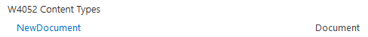
Results

Slide 41
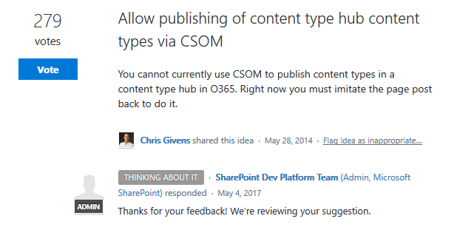
Publish a Content Type
Not currently possible via PowerShell

Slide 42
Other Options
Manual publish
IE Automation
See http://www.constellationsolutions.com/how-to/publish-content-types-powershell-sharepoint-online/ for an example

Slide 43
Add Content Type to Library
Adding a content type to a library using PnP does not require that ‘Allow management of content types’ option is enabled for the library/list. The PnP PowerShell command does this for you.
Add-PnPContentTypeToList -List "Documents" -ContentType "NewDocument" -DefaultContentType

Slide 44
Remove a Content Type
Having added a new content type to a library or list, you probably want to remove the default ‘Document’/’Item’ content type.
Remove-PnPContentTypeFromList –List "Documents" -ContentType "Document"

Slide 45
Create Library View
Using SharePoint PnP it is very easy to generate a view to apply to a list.
Add-PnPView -List "Demo List" -Title "Demo View" -Fields "Title","Address
Use the –SetAsDefault parameter to make the view you are creating the default on the list.

Slide 46
Deleting All List Items

Slide 47
Deleting All List Items
Useful for development and testing, when we tend to end up with large numbers of items in a list/library.
First things first: Get all list items:
Get-PnPListItem -List "List1“

Slide 48
To Recycle or Delete?
Move items to the recycle bin:
$ListItems = Get-PnPListItem -List "List1"
foreach ($listItem in $ListItems) {
Move-PnPListItemToRecycleBin -List "List1" -Identity $ListItem.ID -Confirm:$false
}

Slide 49
To Recycle or Delete
Delete the list items:
$ListItems = Get-PnPListItem -List "List1"
foreach ($listItem in $ListItems) {
Remove-PnPListItem -List "List1" -Identity $ListItem.ID -Confirm:$false
}
But, we can also add the ‘-Recycle’ parameter to this command…

Slide 50
Featured Links List Items

Slide 51
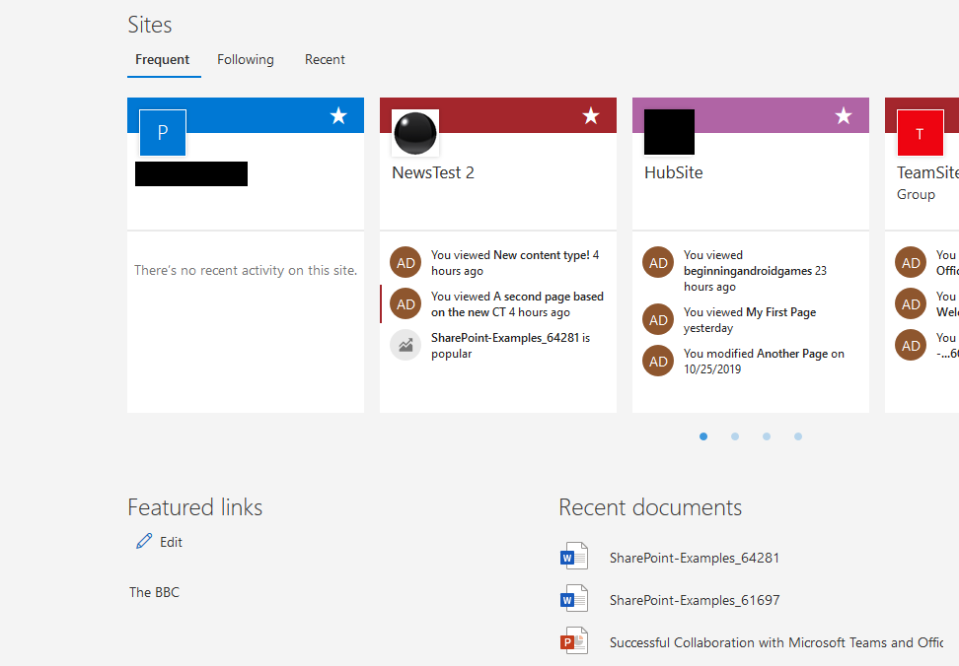
What Are We Talking About?

Slide 52
Featured Links – Hidden List
The Featured Links are stored in a hidden list in the root site collection of your tenant.
/Lists/SharePointHomeOrgLinks/AllItems.aspx
It’s just a SharePoint list
We can create items on this list the same way we’d create other list items…

Slide 53
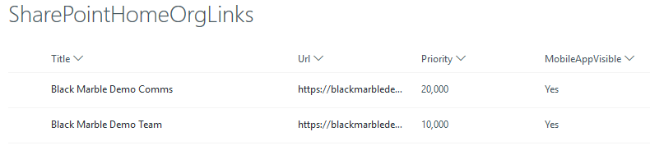
What Does the List Look Like?

Slide 54
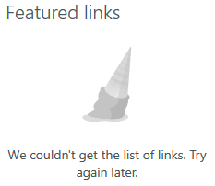
Fields We Need To Add Data For
We need to add an item to this list populating the following fields:
Title
Url
Priority (in multiples of 10,000 by default, however you seem to be able to specify any value; higher values = higher up the list)
MobileAppVisible (1=Yes/0=No)
All fields are optional except Title However if you don’t fill them in…

Slide 55
Adding a Featured Link
Add-PnPListItem -List "SharePointHomeOrgLinks" -Values @{"Title" = “The BBC"; "Url"="http://www.bbc.co.uk"; "Priority"="30000"; "MobileAppVisible"="1"}

Slide 56
Navigation

Slide 57
Adding a Navigation Node
Specify:
Location (TopNavigationBar, QuickLaunch, SearchNav)
Title
Url
Add-PnPNavigationNode -Location TopNavigationBar -Title "New Nav Node" -Url "/sites/Test/"
Show the existing navigation nodes
Get-PnPNavigationNode -Location TopNavigationBar -tree

Slide 58
Multi-Level Navigation Nodes
We can add multi-level navigation nodes to the top navigation bar using PowerShell:
$node = Add-PnPNavigationNode -Location TopNavigationBar -Title “Top Level" -Url "/sites/Test/" # Top level node
$node2 = Add-PnPNavigationNode -Location TopNavigationBar -Title “Sub-Level" -Url "/sites/Test2/" -Parent $node.id

Slide 59
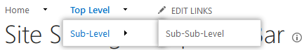
Multi-Level Navigation Result

Slide 60
Enable the New MegaMenu
This should be enabled on new sites that support it by default when it rolls out.
To enable it on existing sites (or similar for disabling it):
Connect-PnPOnline -Url https://mydomain.sharepoint.com
$web = Get-PnPWeb
$web.MegaMenuEnabled = $true
$web.Update()
Invoke-PnPQuery

Slide 61
Property Bag Configuration

Slide 62
Property Bag Configuration
The code to enable the MegaMenu shows how ‘normal’ settings can also be manipulated:
$web.MegaMenuEnabled = $true
$web.Update()
Invoke-PnPQuery

Slide 63
Set Site Collection Region
Limited set of regions allowed during site collection creation, sadly the UK isn’t one of them…
Connect-PnPOnline -Url https:// mydomain.sharepoint.com -Credentials $cred
# Get the context of the current web we're connected to
$Web = Get-PnPWeb
# Modify the regional settings
$web.RegionalSettings.LocaleId = 2057
$web.Update()
Invoke-PnPQuery

Slide 64
We Can Get/Set PropertyBag Values…
Get-PnPPropertyBag -Key MyKey
Set-PnPPropertyBagValue -Key MyKey -Value MyValue
Which is fine, if you know the keys…

Slide 65
Showing PropetyBag Keys
Get-PnPPropertyBag
# And that's it...

Slide 66
Or You Could do it the Hard Way…
function ReadSPO-PropertyBags { param ($SiteUrl,$UserName,$Password) try { #Reference the Client OM Assemblies Add-Type -Path "C:\Program Files\PackageManagement\NuGet\Packages\Microsoft.SharePointOnline.CSOM.16.1.8523.1200\lib\net45\Microsoft.SharePoint.Client.dll" Add-Type -Path "C:\Program Files\PackageManagement\NuGet\Packages\Microsoft.SharePointOnline.CSOM.16.1.8523.1200\lib\net45\Microsoft.SharePoint.Client.Runtime.dll"
#SPO Client Object Model Context $spoCtx = New-Object Microsoft.SharePoint.Client.ClientContext($SiteUrl) $spoCredentials = New-Object Microsoft.SharePoint.Client.SharePointOnlineCredentials($UserName, $Password) $spoCtx.Credentials = $spoCredentials

Slide 67
The Hard Way (Part 2)
$spoSiteCollection=$spoCtx.Site
$spoCtx.Load($spoSiteCollection)
$spoRootWeb=$spoSiteCollection.RootWeb
$spoCtx.Load($spoRootWeb)
$spoAllSiteProperties=$spoRootWeb.AllProperties
$spoCtx.Load($spoAllSiteProperties)
$spoCtx.ExecuteQuery()
$spoPropertyBagKeys=$spoAllSiteProperties.FieldValues.Keys

Slide 68
The Hard Way (Part 3)
foreach($spoPropertyBagKey in $spoPropertyBagKeys){
Write-Host "PropertyBag Key: " $spoPropertyBagKey " - PropertyBag Value: " $spoAllSiteProperties[$spoPropertyBagKey] -ForegroundColor Green
}
$spoCtx.Dispose() } catch [System.Exception]
{ write-host -f red $_.Exception.ToString() } }

Slide 69
And Now actually Call The Function…
#Required Parameters
$SiteUrl = "https://<Office365Domain>.sharepoint.com/sites/Test/"
$UserName = "<Office365User@Office365Domain.SharePoint.com>"
#$Password = Read-Host -Prompt "Enter your password: " -AsSecureString
$Password=convertto-securestring "<Office365_Password>" -asplaintext -force
ReadSPO-PropertyBags -sSiteUrl $SiteUrl -sUserName $UserName -sPassword $Password

Slide 70
Page Creation/Manipulation

Slide 71
Page Creation/Manipulation
Need to create a new home page?
Add-PnPClientSidePage -Name "MyPage" -LayoutType Home -CommentsEnabled:$false
Add a page section (seems to delete the default page content…)
Add-PnPClientSidePageSection -Page "MyPage" -SectionTemplate ThreeColumn [-Order 1|2|3…]
Add a web part to a page
Add-PnPClientSideWebPart -Page "MyPage" -DefaultWebPartType Image -Section 1 -Column 1 -WebPartProperties <PropertyBagDetails>

Slide 72
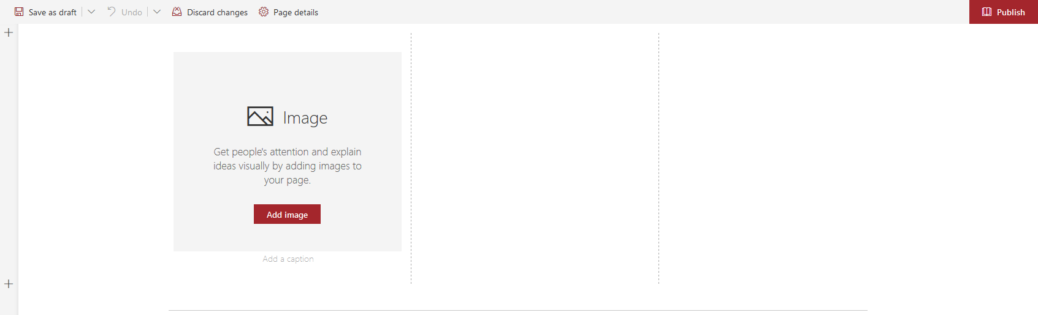
Page Creation/Manipulation Result

Slide 73
Recap

Slide 74
Recap
PnP PowerShell is incredibly powerful
PnP PowerShell is significantly quicker and easier to write than other methods of automation
There are still things that PnP PowerShell cannot do. In many cases CSOM PowerShell also cannot do them.

Slide 75
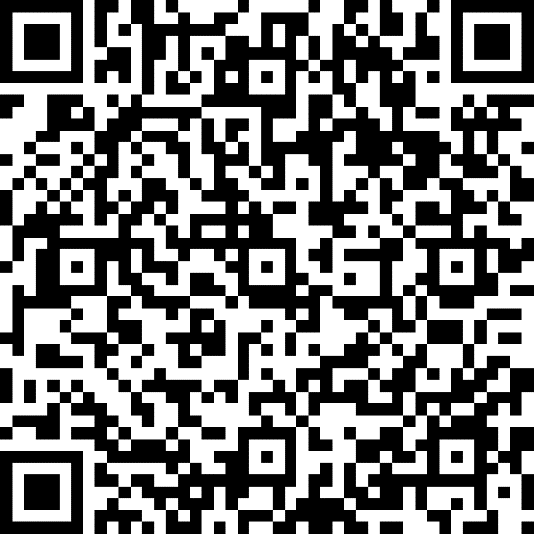
Please evaluate my session
http://bit.ly/SPSLeics2019

Slide 76




Questions?
@W4050
blogs.blackmarble.co.uk/blogs/adawson

